Slide 1
ALPhA Week 4: (2/9/19 – 2/15/19)
Gray Selby
AT-TPC Alpha – Alpha Classification

Slide 2
Week 4
Learned how to use the linux screen command
Started looking at Ryan’s github code
Learned about hdf5 files

Slide 3
hdf5 file “run_0210.h5”
Used HDFView application to visualize the file
There is one group titled “get”
Within this group there are 74 events
Each event is a 10240 x 517 array
Rows correspond to pad numbers
Columns correspond to time values
The first six columns seem to hold other values
Columns 0,1,2 have single digit values
Column 3 has one or two digit values
Column 4 has a value of 20,000
Column 5 has values of either 0 or a large value (multiple digits)
Columns 6-517 have three digit values corresponding to quantity of charge

Slide 4
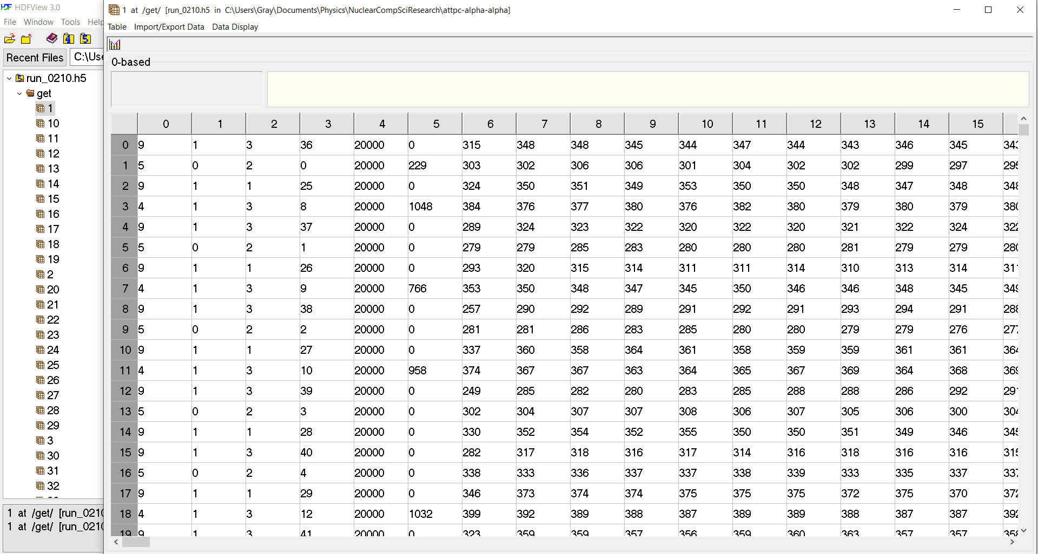
HDFView displaying the array for event 1
Data removed from preliminary analysis
Charge Values

Slide 5
Finding charge ‘cut off’ value
In a Jupyter notebook I created a function that plots a histogram of max charge values per pad across all events
I also created a function that plots a histogram of max charge values per pad for a specified event

Slide 6
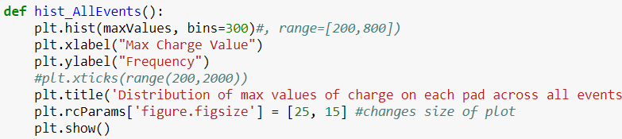
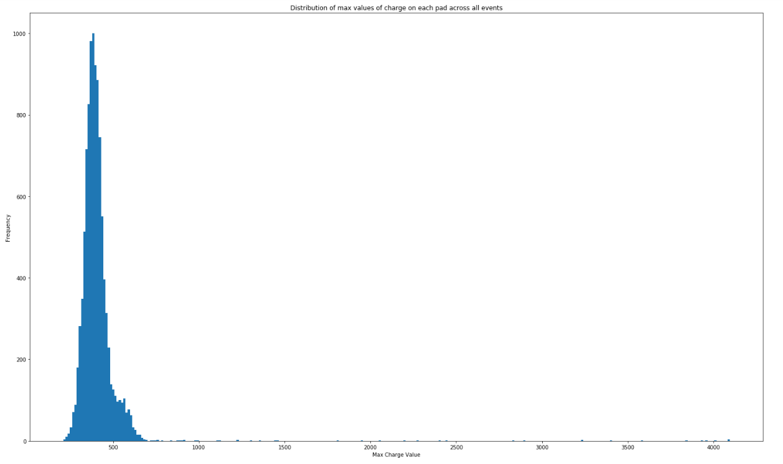

Slide 7
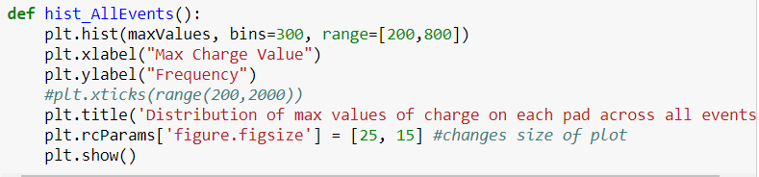
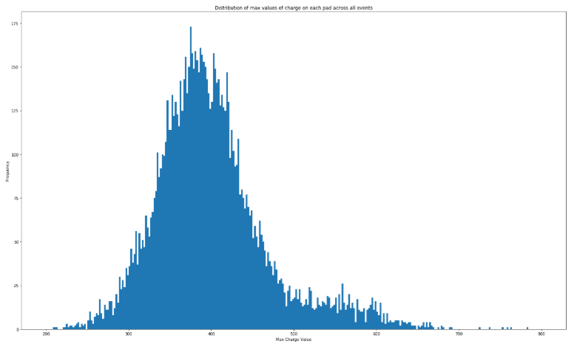

Slide 8
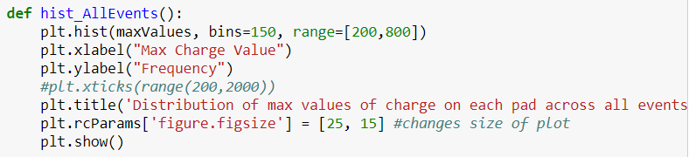
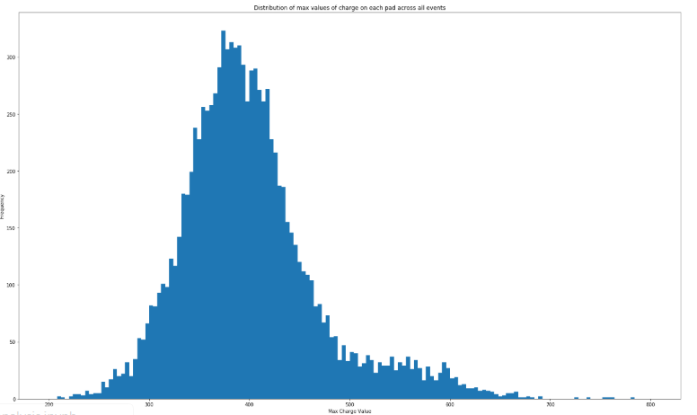

Slide 9
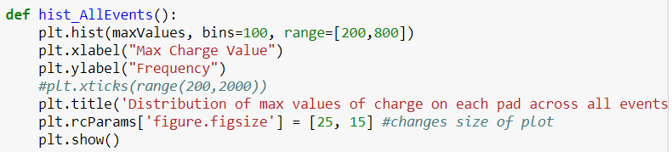
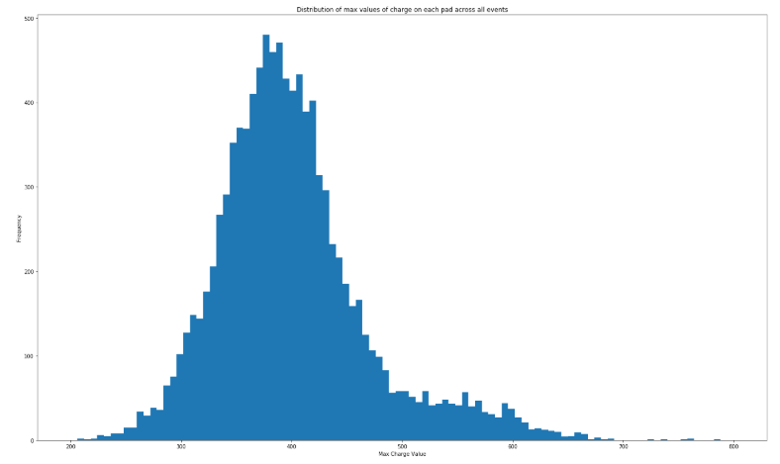

Slide 10
Now for individual events

Slide 11
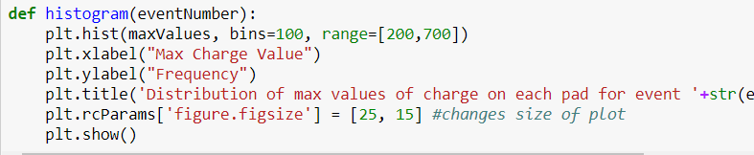
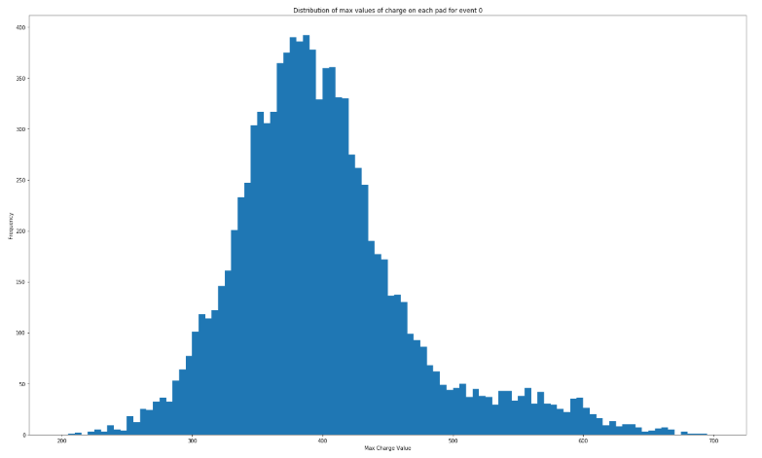

Slide 12

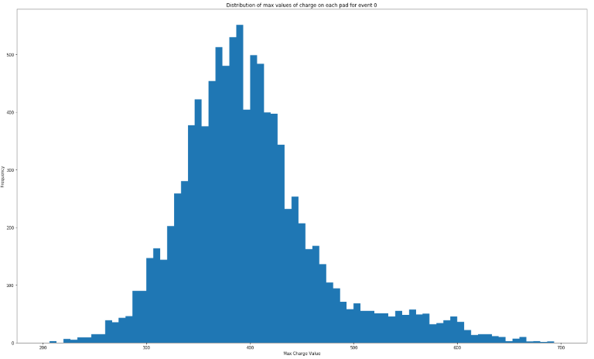

Slide 13

For the following binning and range:

Slide 14
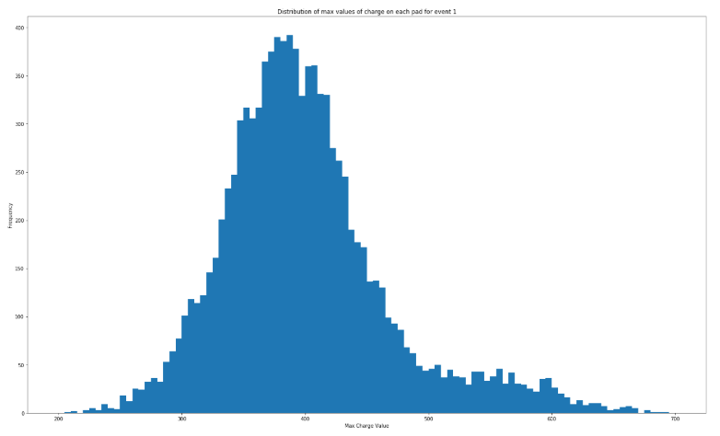

Slide 15
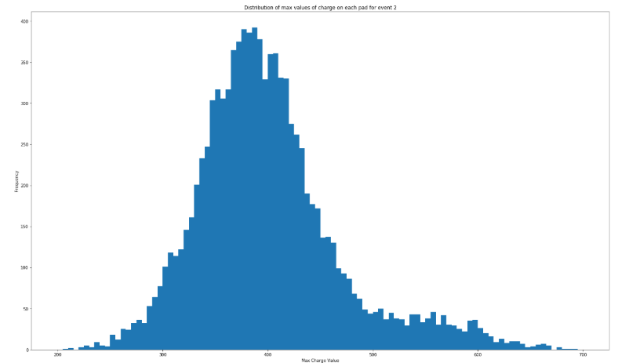

Slide 16
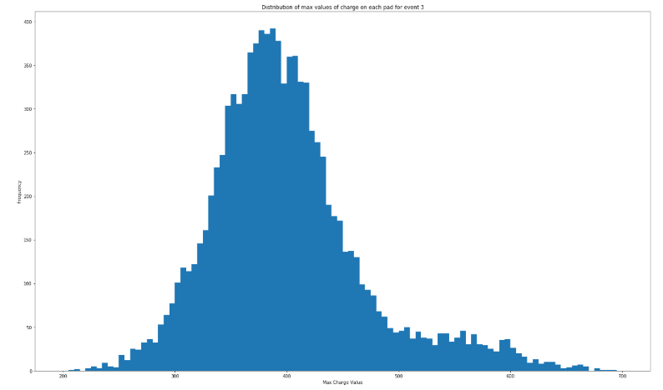

Slide 17


Slide 18


